Slide 1

rate
A model to predict whether a new apartment will be good or not
Ariel Ben Haim & Noa Yarkoni

Slide 2

Introduction
Our project will revolve around AIRBNB website.
We will examine whether price, rating and other parameters can affect the rating of a apartment by the tools we acquired in this course.

Slide 3

Research Question:
Can we predict the rate apartment will get on AirBnb?

Slide 4

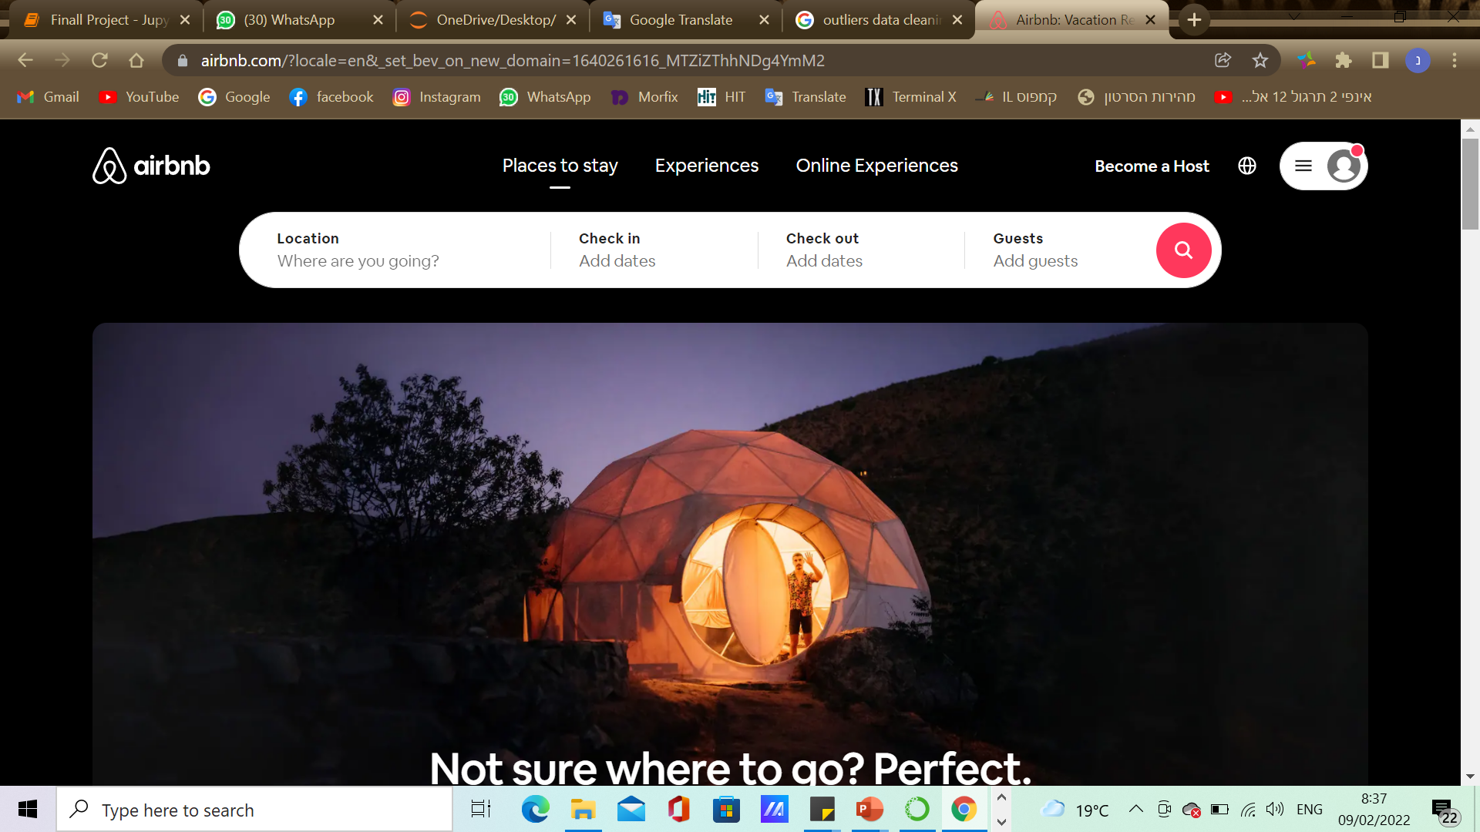
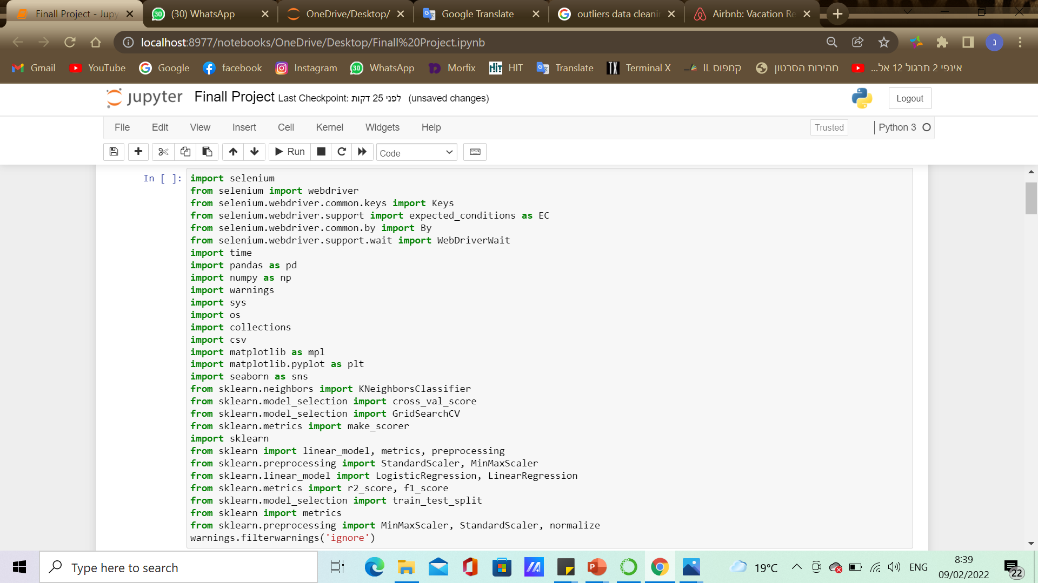
Web Crawling
We got our data from :
https://www.airbnb.com/
Libraries we used:
selenium , requests, pandas, numpy, matplotlib, time, sklearn, seaborn…
our import list:

Slide 5

How we used the selenium library?
We went through the list of cities we set out to check in a for loop
With Selenium Library, we entered each city and scanned all the pages and created a list of links of the apartments.
Then for each apartment we extracted the parameters we needed
Once we have created all the lists we need, we saved it in CSV file and moved to Data Frame.

Slide 6
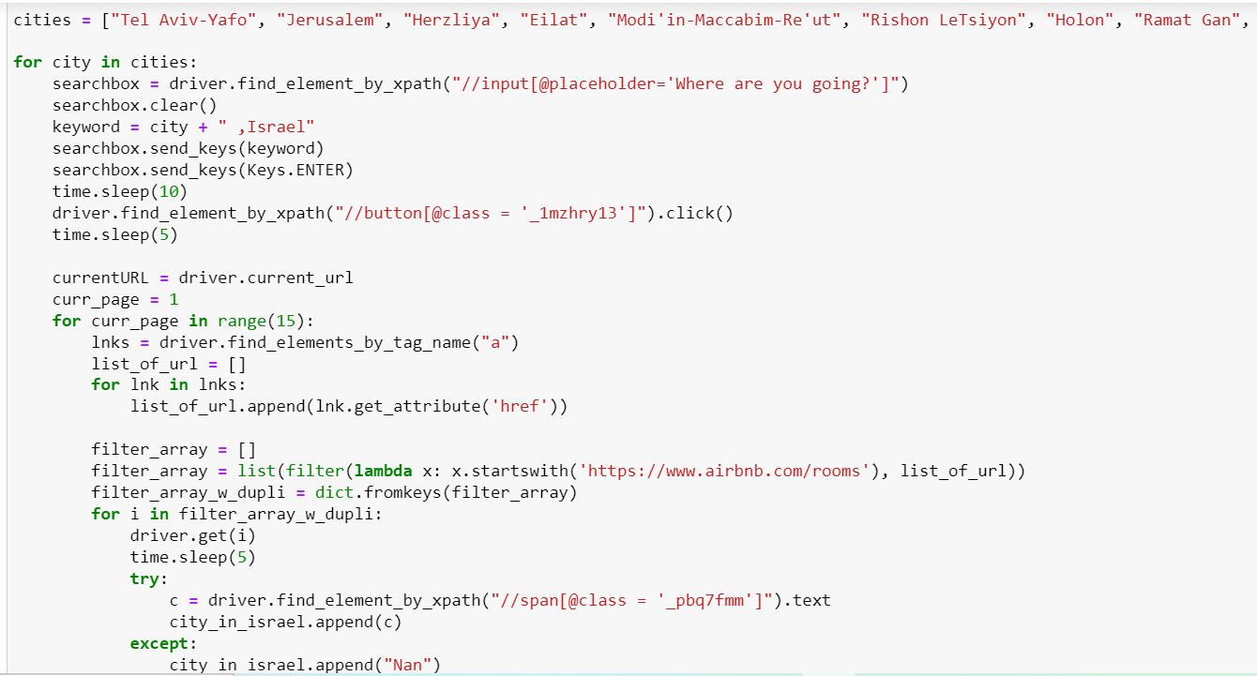
cities list we choose to chek
How we use selenium to make link list

Slide 7
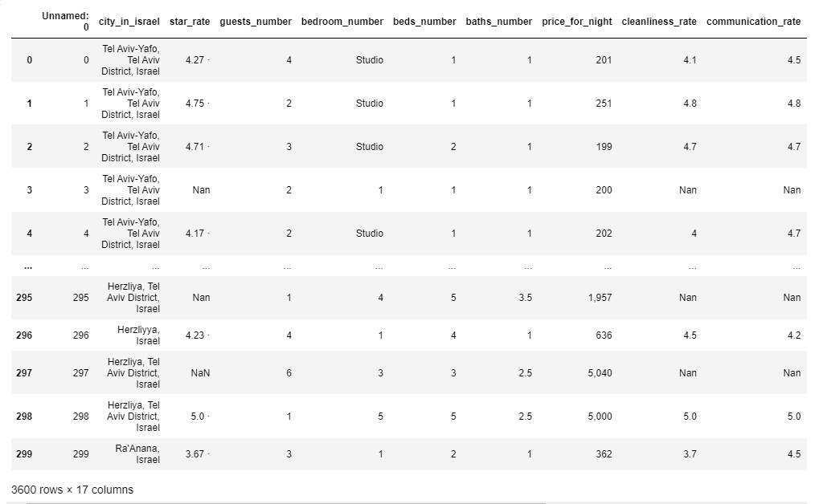

Our Data frame:

Slide 8
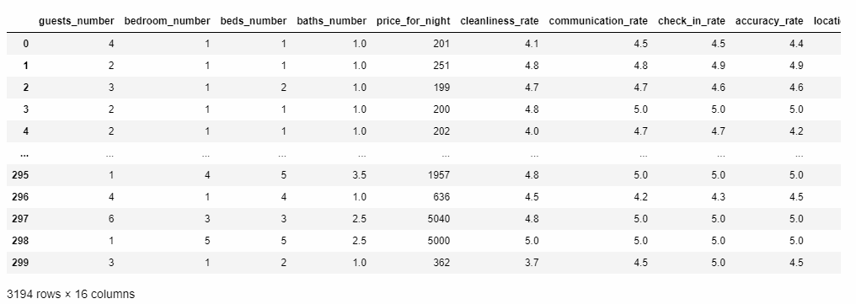












Our Data frame after remove duplicates and Handled missing data

Slide 9
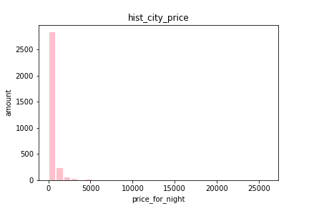
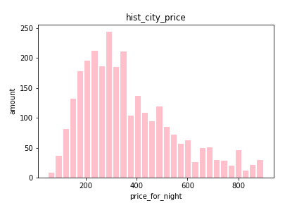
How did we handle the data?
before & after
outliers handling
- Removed missing data.
- Removed duplicates.
- Filled missing values.
- Handled outliers that are not necessary for our needs (Remove higher than usual prices).

Slide 10

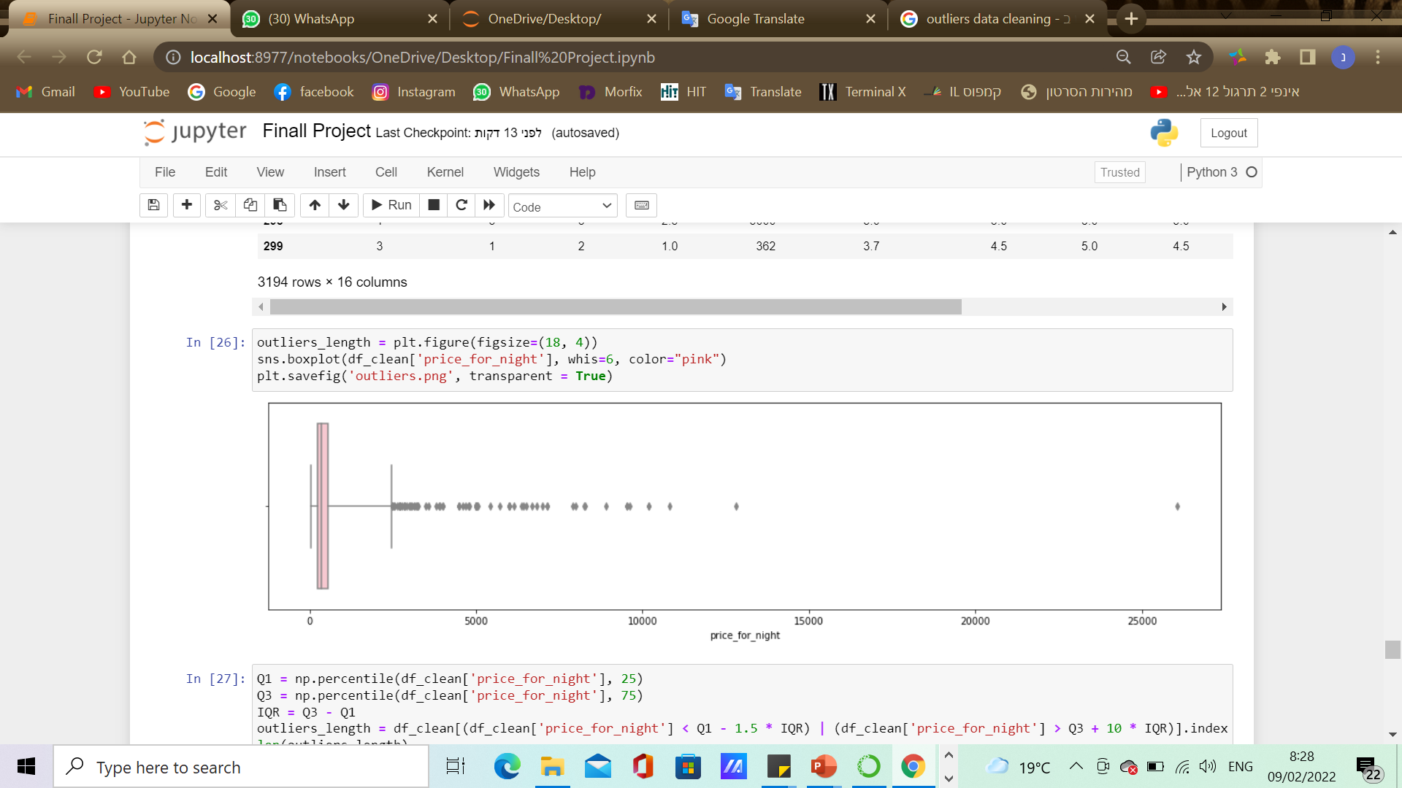
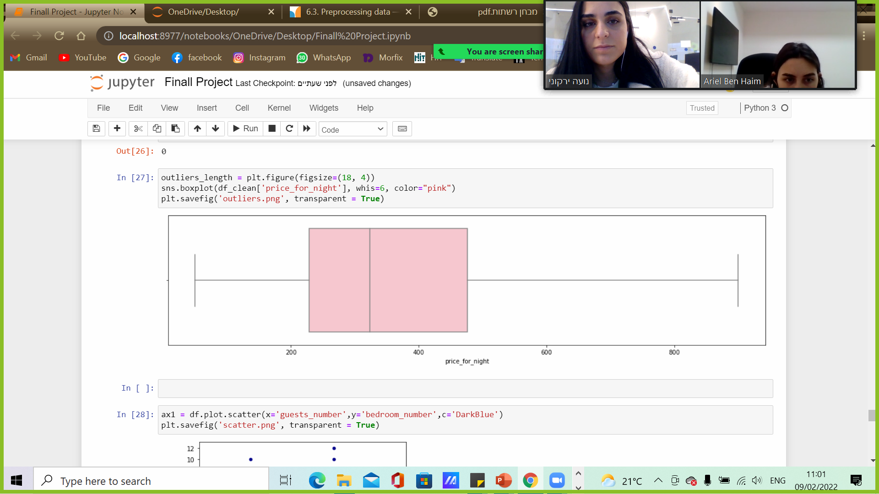
Outliers plot of price for night:
before & after
outliers handling

Slide 11
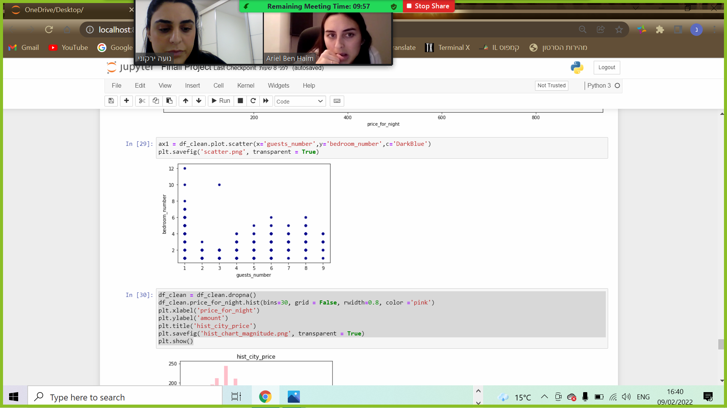
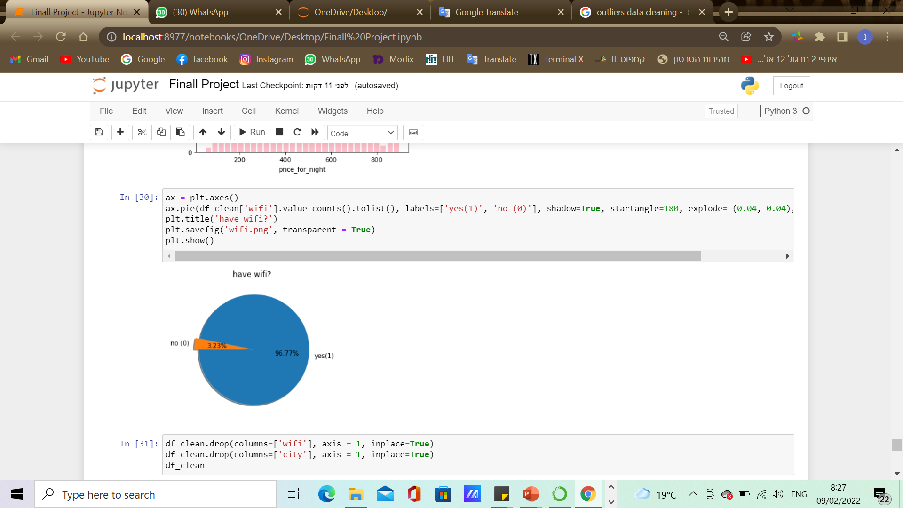
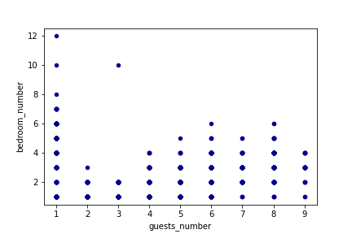
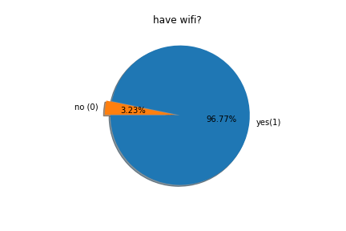
Visualization & Evaluation

Slide 12
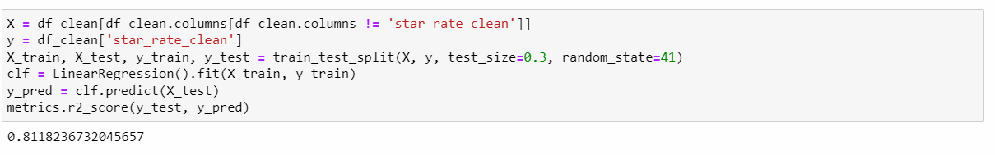
Machine Learning: Linear Regression

Slide 13

Conclusion
We were able to predict if an apartment will get high rate by its parameters.
We came to a conclusion that there is a strong linear connection between an apartment parameters and its rate on airbnb

Slide 14

Thank You!

